Slide 1
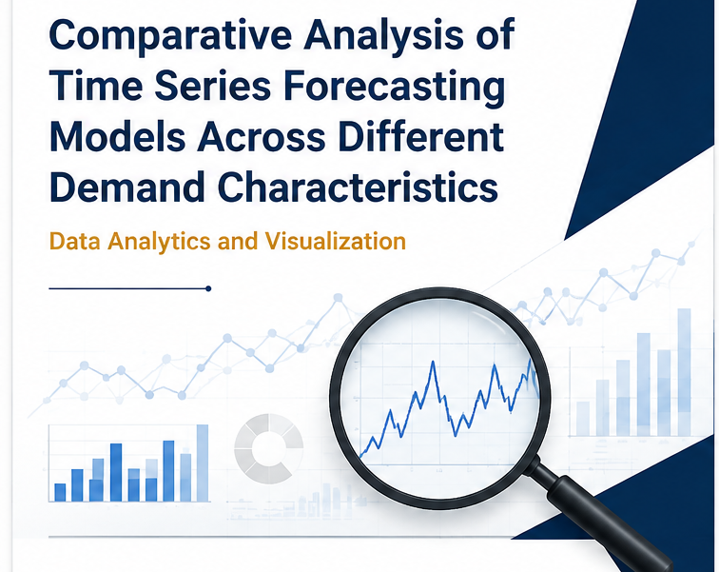
Comparative Analysis of Time Series Forecasting Models Across Different Demand Characteristics
Team: J Saidarsh ,M Siddardha ,Nekkanti Abhinav, G Anirudh
University IDs: 2420030145 / 2420030214 / 2420030470 / 2420030758
Guide: Dr. Swapnika— Section: 1
Department of Computer Science & Engineering

Slide 2


PROBLEM STATEMENT
The Central Research Problem
Demand forecasting estimates future demand from historical observations, critical across retail, inventory, production, transportation, energy, and resource allocation. Demand series vary in trend, seasonality, intermittency, variability, and temporal dependence — each influencing how forecasting approaches perform.
Research Question: "How does the relative performance and practical suitability of established time-series forecasting models change across different demand characteristics?"

Slide 3
OBJECTIVES
Research Objectives
Research & Experiment Design (1–6)
Implementation, Evaluation & Findings (7–11)
Study recent forecasting research and benchmarks
Identify gaps in fair comparison and model suitability
Select benchmark datasets with diverse demand characteristics
Analyze datasets for trend, seasonality, intermittency, variability
Select established models with suitable baselines
Design chronological train/val/test avoiding data leakage
Implement methods and generate forecasts
Evaluate using multiple error measures
Compare performance across datasets and characteristics
Derive suitability conclusions per demand behavior
Maintain reproducible workflow for final submission
Literature → Gap → Datasets → Characterization → Models → Evaluation → Comparison → Findings

Slide 4
LITERATURE SURVEY
Recent Research — Papers 1–5
#
Paper Title
Year · Venue
Contribution & Relevance
1
A Survey of Deep Learning for Time Series Forecasting: Taxonomy, Analysis and Future Directions
2026 · IEEE TKDE
Taxonomy of DL methods; guides model selection
2
An autoregressive lag aware sparse transformer framework for demand forecasting
2026 · Discov. AI, Springer
Sparse transformer for demand; links architecture to demand patterns
3
Artificial intelligence and classical statistical models for time series forecasting: a comprehensive review
2025 · J. Big Data, Springer
AI vs. statistical comparison; informs baseline inclusion
4
Deep learning for time series forecasting: a survey
2025 · Int. J. Mach. Learn. Cybern., Springer
DL survey; contextualizes deep-learning scope
5
A comprehensive survey of deep learning for time series forecasting: architectural diversity and open challenges
2025 · Artif. Intell. Rev., Springer
Architectural diversity and open challenges; informs benchmarking design

Slide 5
LITERATURE SURVEY
Recent Research — Papers 6–10
#
Paper Title
Year · Venue
Contribution & Relevance
6
Electricity demand forecasting methodologies and applications: a review
2025 · Sustain. Energy Res., Springer
Electricity demand review; supports energy dataset
7
Developing a demand planning strategy for joint forecasting and employing analytical tool in an empirical case study
2025 · Discov. Appl. Sci., Springer
Joint demand planning case study; motivates multi-dataset design
8
Boosting time series forecasting accuracy with Holt-Winters and artificial neural networks
2025 · Discov. Appl. Sci., Springer
Holt-Winters + ANN hybrid; justifies classical + ML baseline
9
TFB: Towards Comprehensive and Fair Benchmarking of Time Series Forecasting Methods
2024 · PVLDB, ACM
Fair benchmarking framework; directly informs evaluation protocol
10
TSFM-Bench: A Comprehensive and Unified Benchmark of Foundation Models for Time Series Forecasting
2025 · KDD, ACM
Foundation model benchmark; highlights standardized evaluation need
Literature → Understanding of Existing Work → Research Gap → Objectives

Slide 6
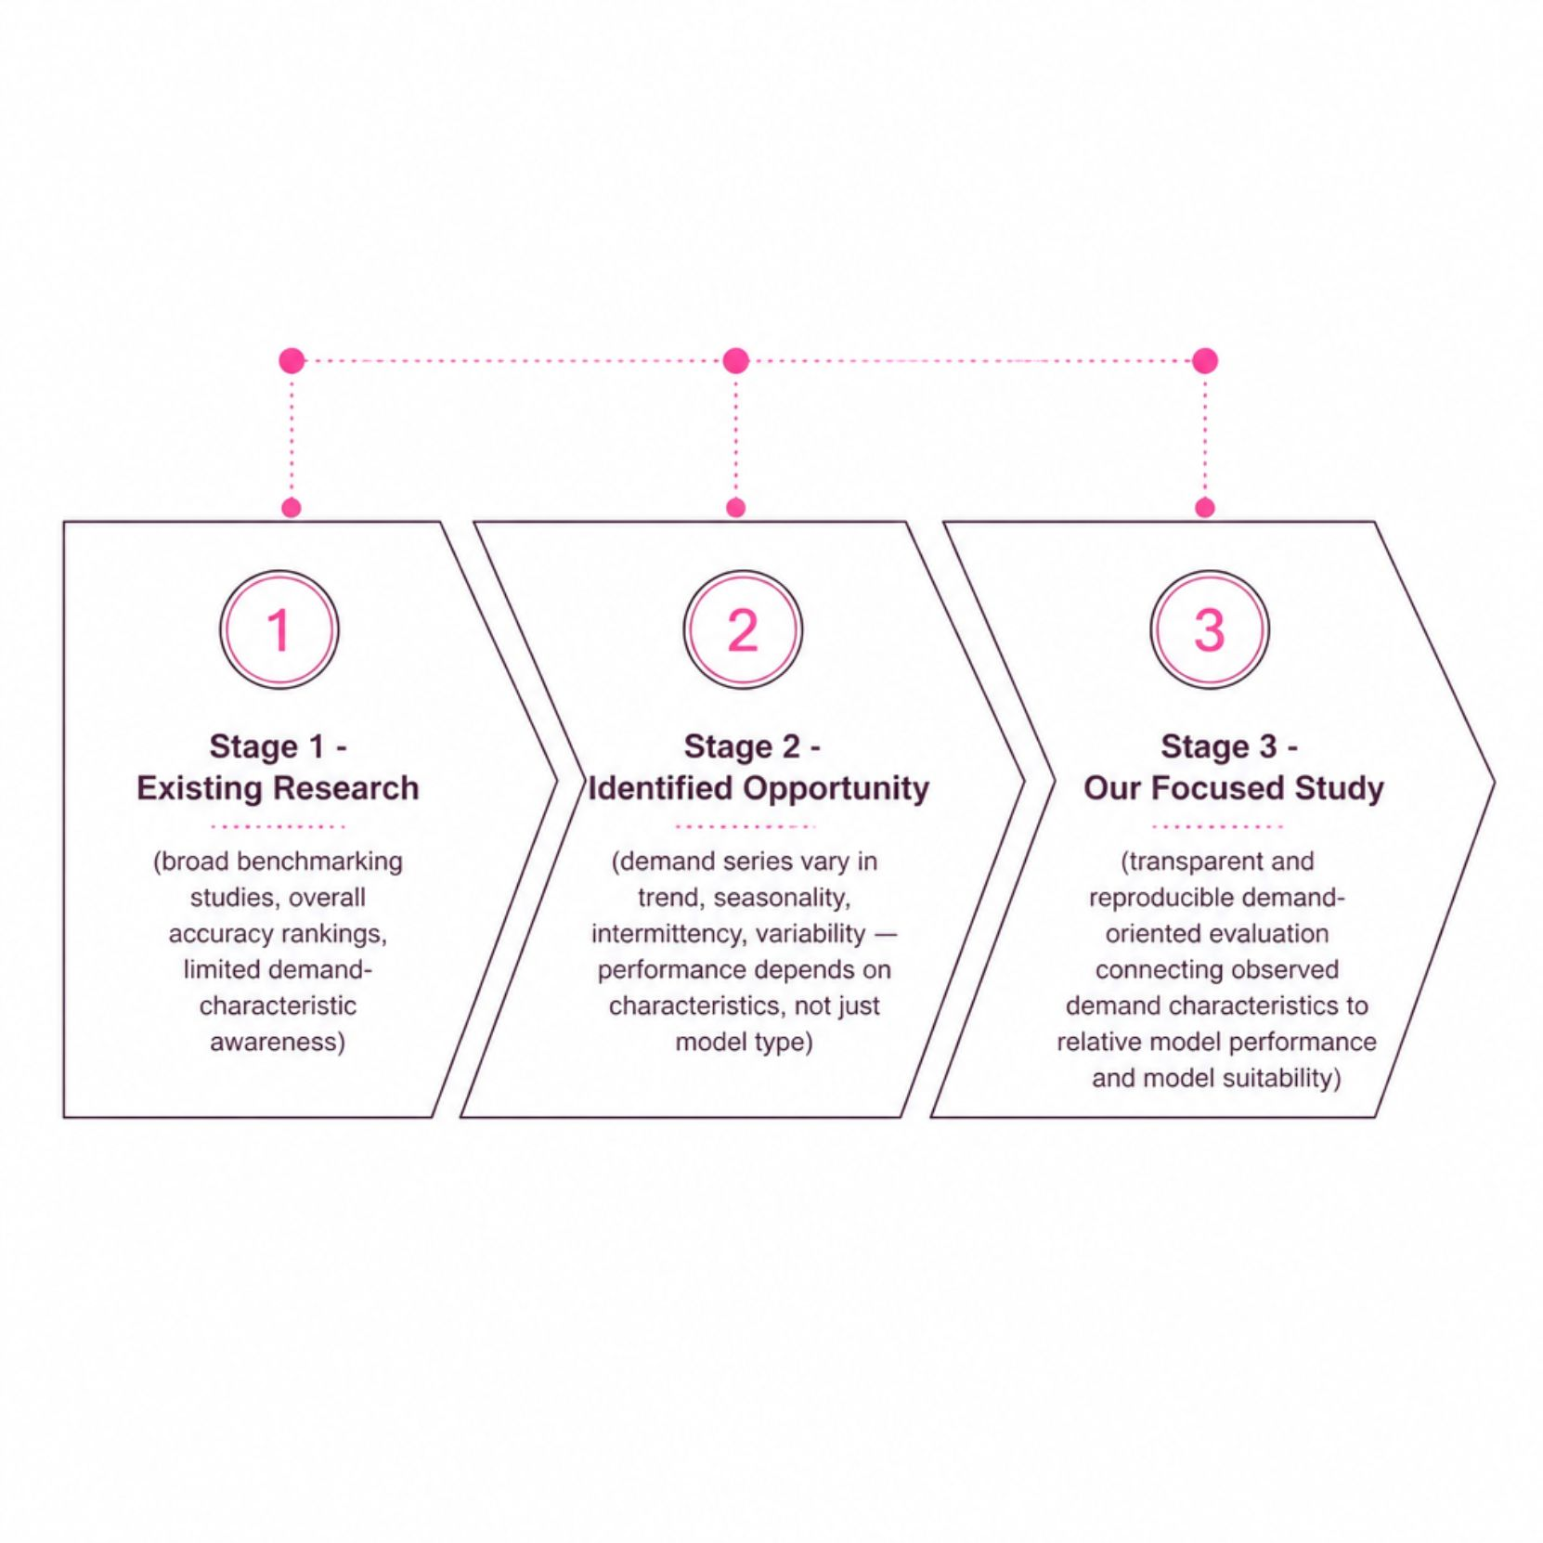
RESEARCH GAP
Research Gap Identification
Forecasting-model comparison is a mature research area. Existing benchmarking studies compare many methods over broad time-series collections.
Our project does not claim novelty from the simple act of comparing models.
Forecasting performance depends on time-series characteristics, dataset selection, evaluation protocol, model set, and forecasting setting. Demand series differ substantially in trend, seasonality, intermittency, and variability.
"There is a need for a focused, transparent and reproducible demand-oriented evaluation that goes beyond a simple overall accuracy ranking and investigates how the relative suitability of established forecasting models changes across different demand characteristics."

Slide 7
INNOVATION
Proposed Contribution
The proposed innovation is empirical and methodological — not the invention of a new forecasting algorithm.
Demand-Characteristic-Aware Comparison
Benchmark-Oriented Evaluation
Common Evaluation Protocol
Use established benchmark datasets
Consistent chronological train/val/test
Characterize series before interpreting performance
Baseline-First Comparison
Multi-Metric Evaluation
Model-Suitability Interpretation
Include simple baselines as references
Multiple error measures, not one metric
Analyze results relative to demand characteristics
Reproducibility
Document data, configuration, and procedure

Slide 8
FEASIBILITY
Feasibility Assessment
Dataset Feasibility
Technical Feasibility
M5 Forecasting — Retail/Walmart unit sales
Tourism Forecasting — Seasonal tourism demand
NN5 Competition — ATM cash withdrawals
Electricity — Energy demand
Dominick Sales — Retail sales
Python · pandas · NumPy · matplotlib · statsmodels · Standard forecasting tools
Modeling Feasibility
Naive · Seasonal Naive · Moving Average
Simple Exponential Smoothing · Holt-Winters
ARIMA · SARIMA
Manageable ML baseline (if justified)
Representative series will be selected to keep experiments manageable.
Computational Feasibility
No specialized hardware required. Core statistical pipeline first; expand after stabilization.

Slide 9
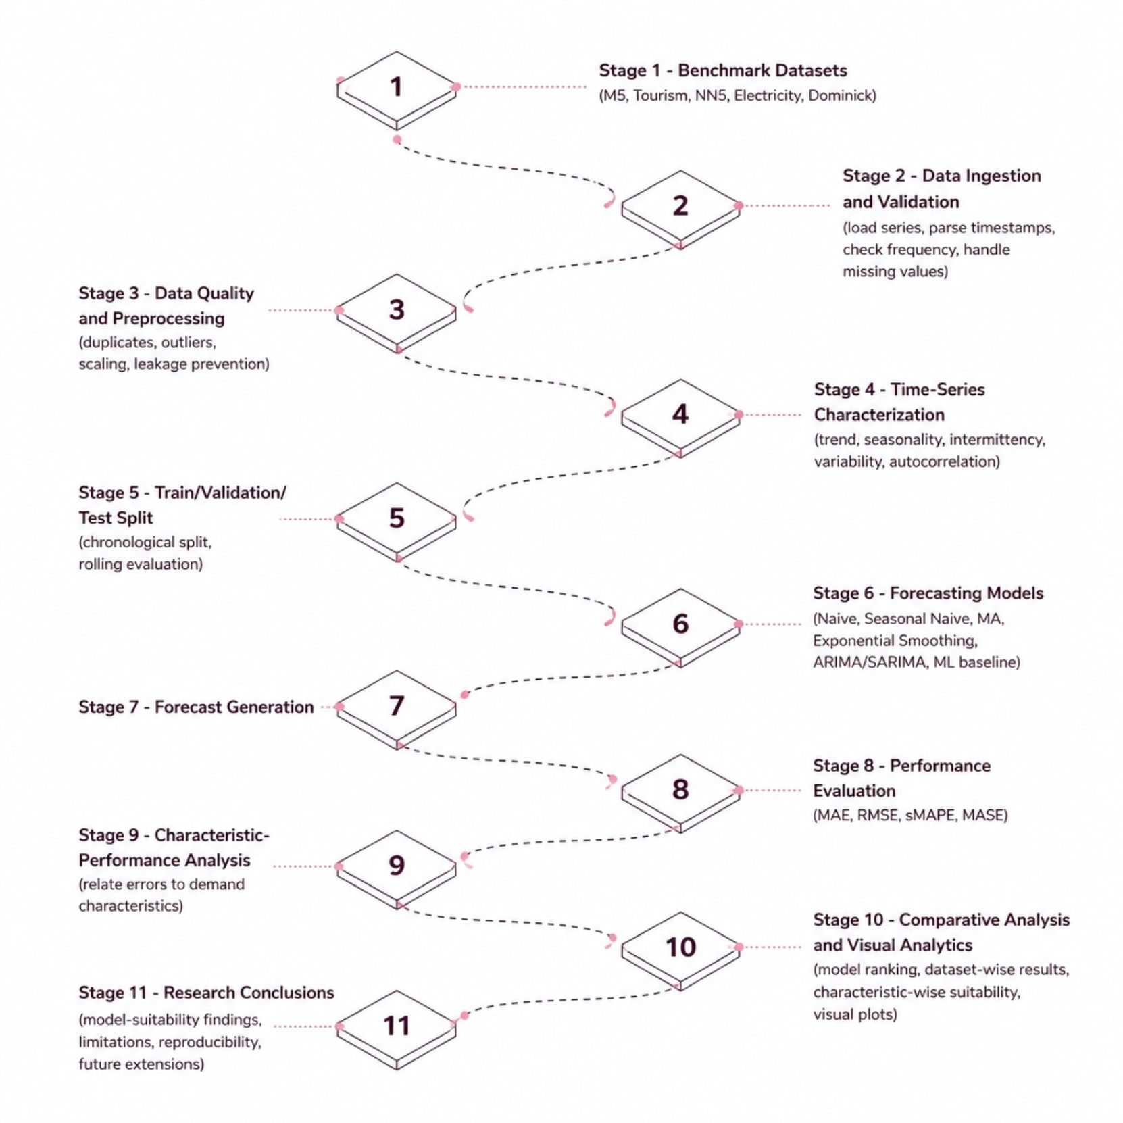
PROJECT PLAN
Project Execution Roadmap
Research Pipeline Overview
The project follows a structured empirical workflow: benchmark datasets are ingested and validated, characterized by demand properties, then subjected to a controlled multi-model forecasting comparison under a consistent chronological evaluation protocol. Results are analyzed characteristic-wise to derive model-suitability insights.

Slide 10
EXPECTED OUTCOME
Expected Research Outcome
The project aims not only to determine which forecasting model produces accurate predictions, but to investigate whether the suitability of established forecasting approaches changes according to the characteristics of the demand series.
Reproducible Workflow
Benchmark Framework
Documented forecasting-analysis pipeline
Multi-dataset experimental design
Multi-Model Evaluation
Suitability Insights
MAE, RMSE, sMAPE, MASE across series
Evidence-based model recommendations per demand behavior
Visual Analytics
Final Documentation
Forecast plots, error comparisons, rankings
Methodology, results, and project report
"Rather than identifying one universally best forecasting model, the project aims to provide evidence-based insights into which established forecasting approaches are more suitable for different demand behaviors."

